Slide 1

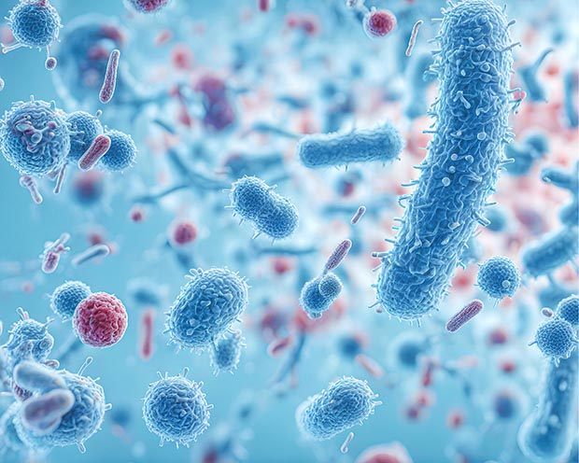
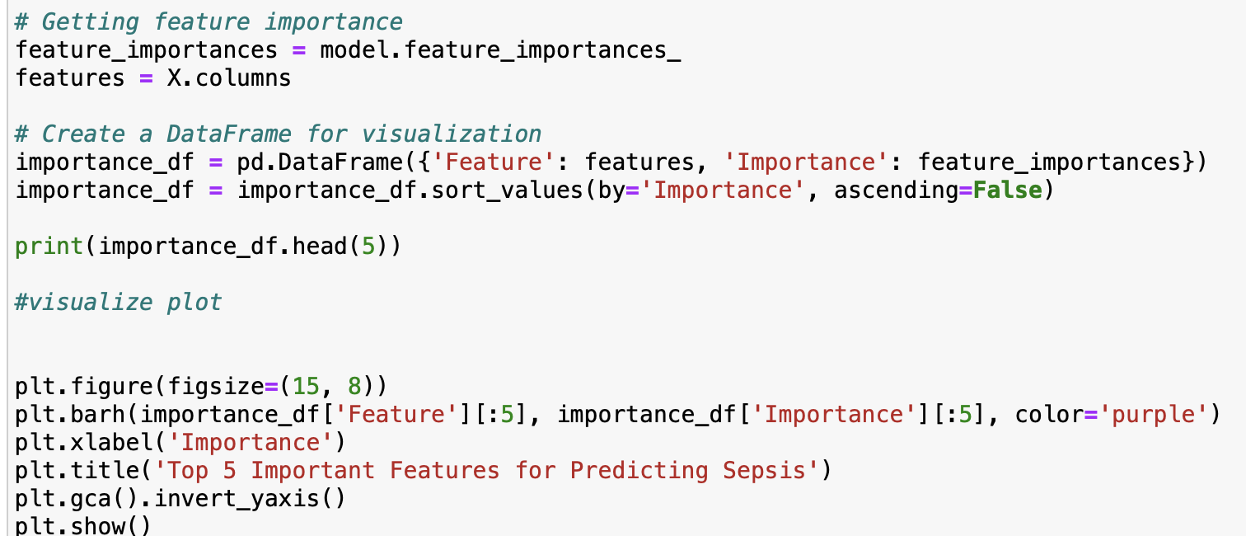
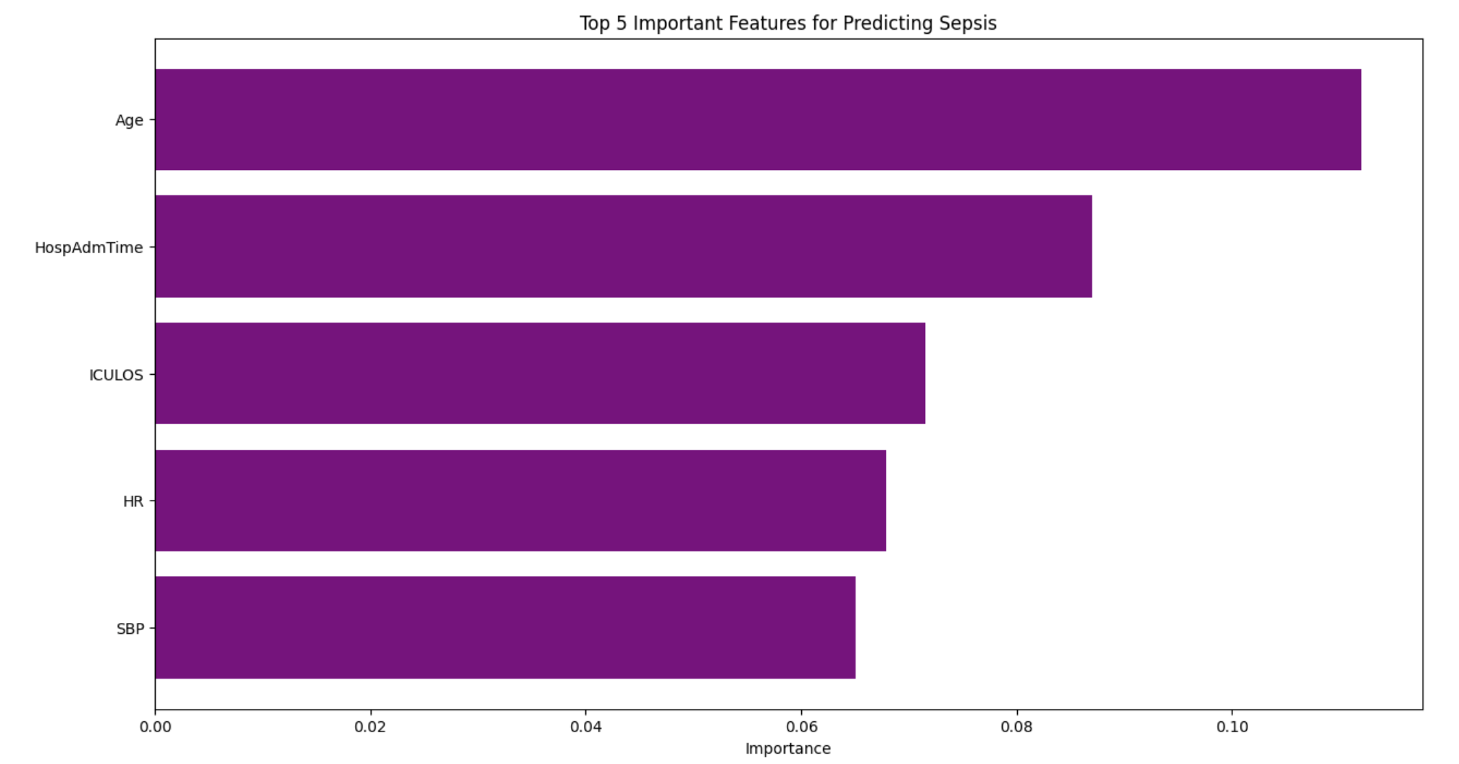
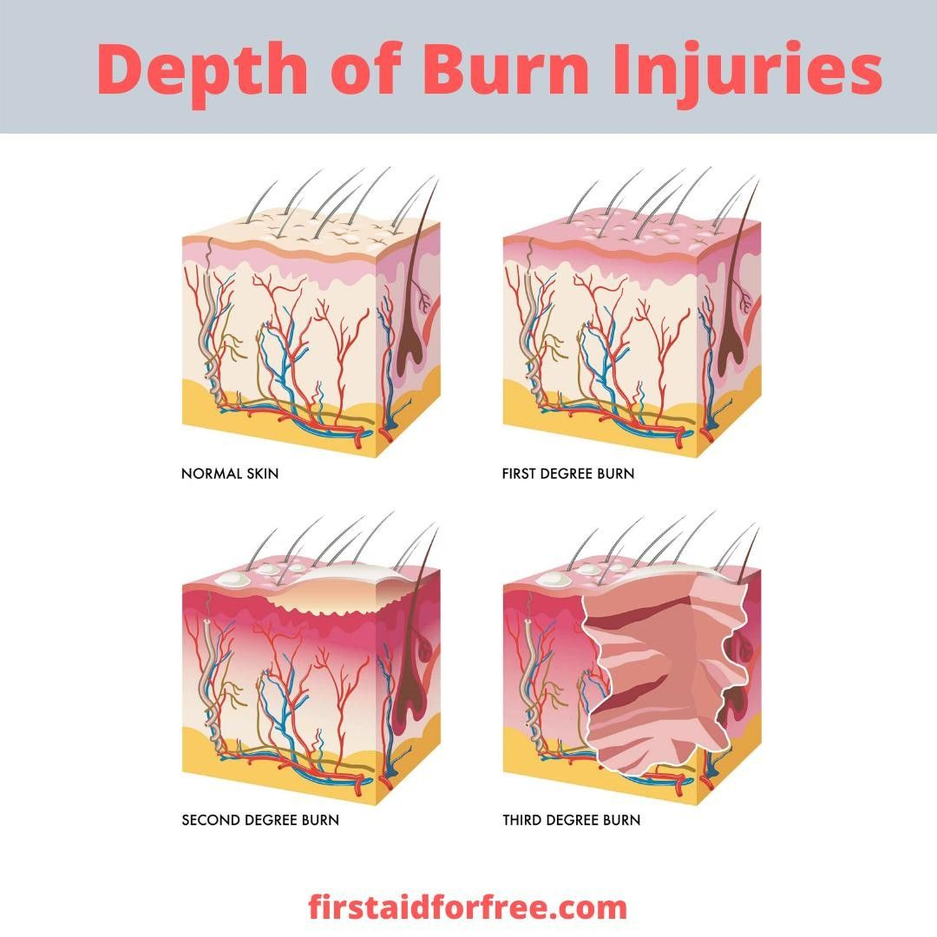
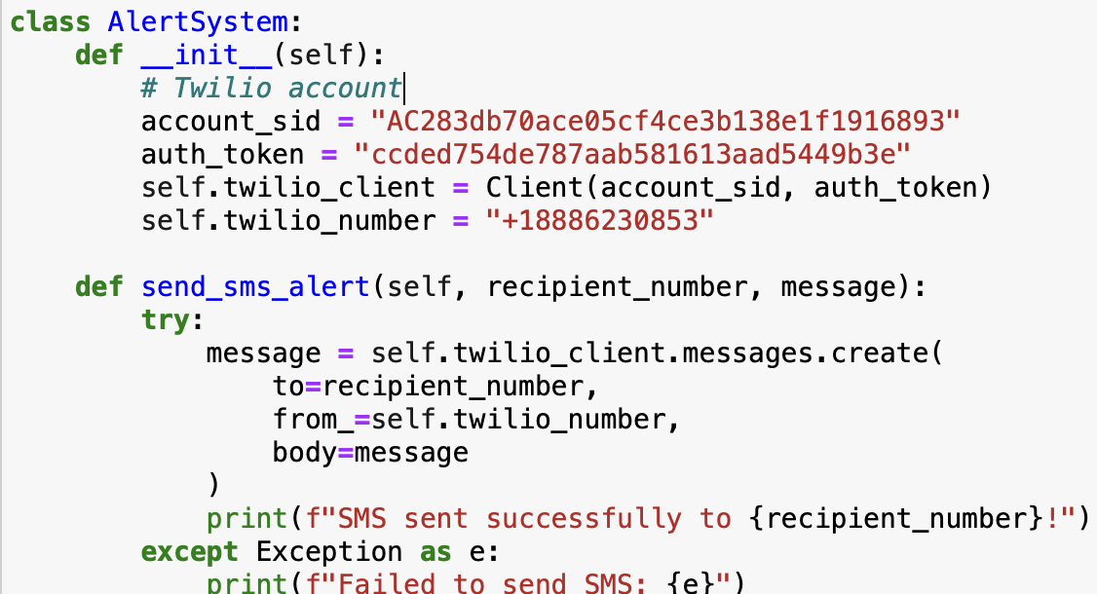
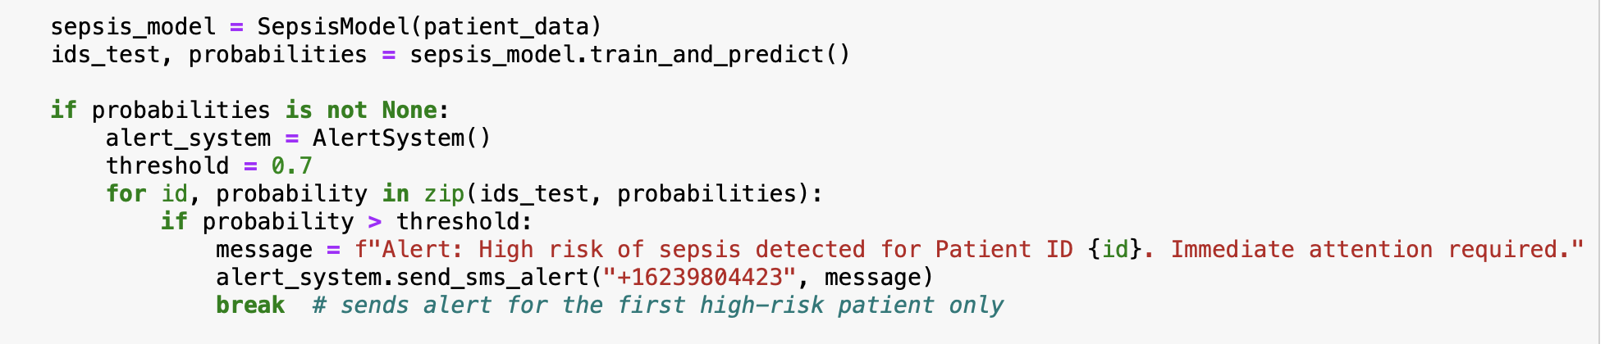
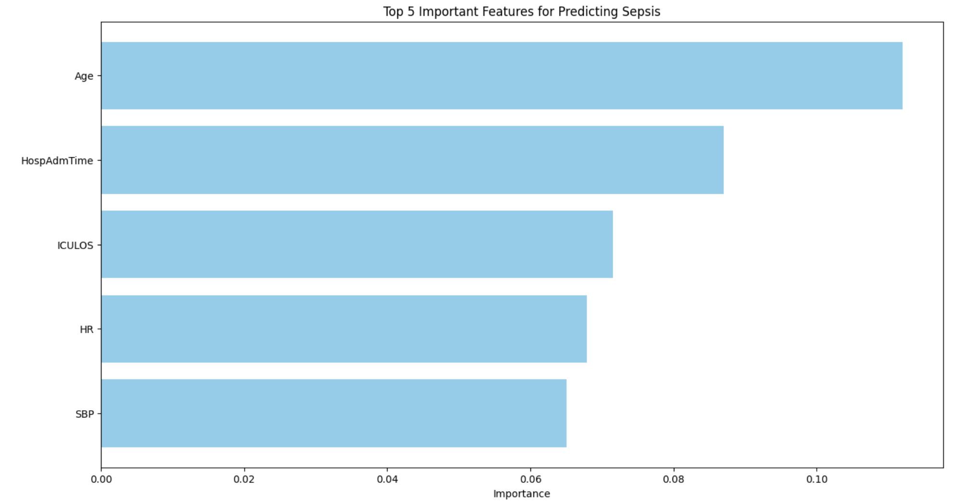
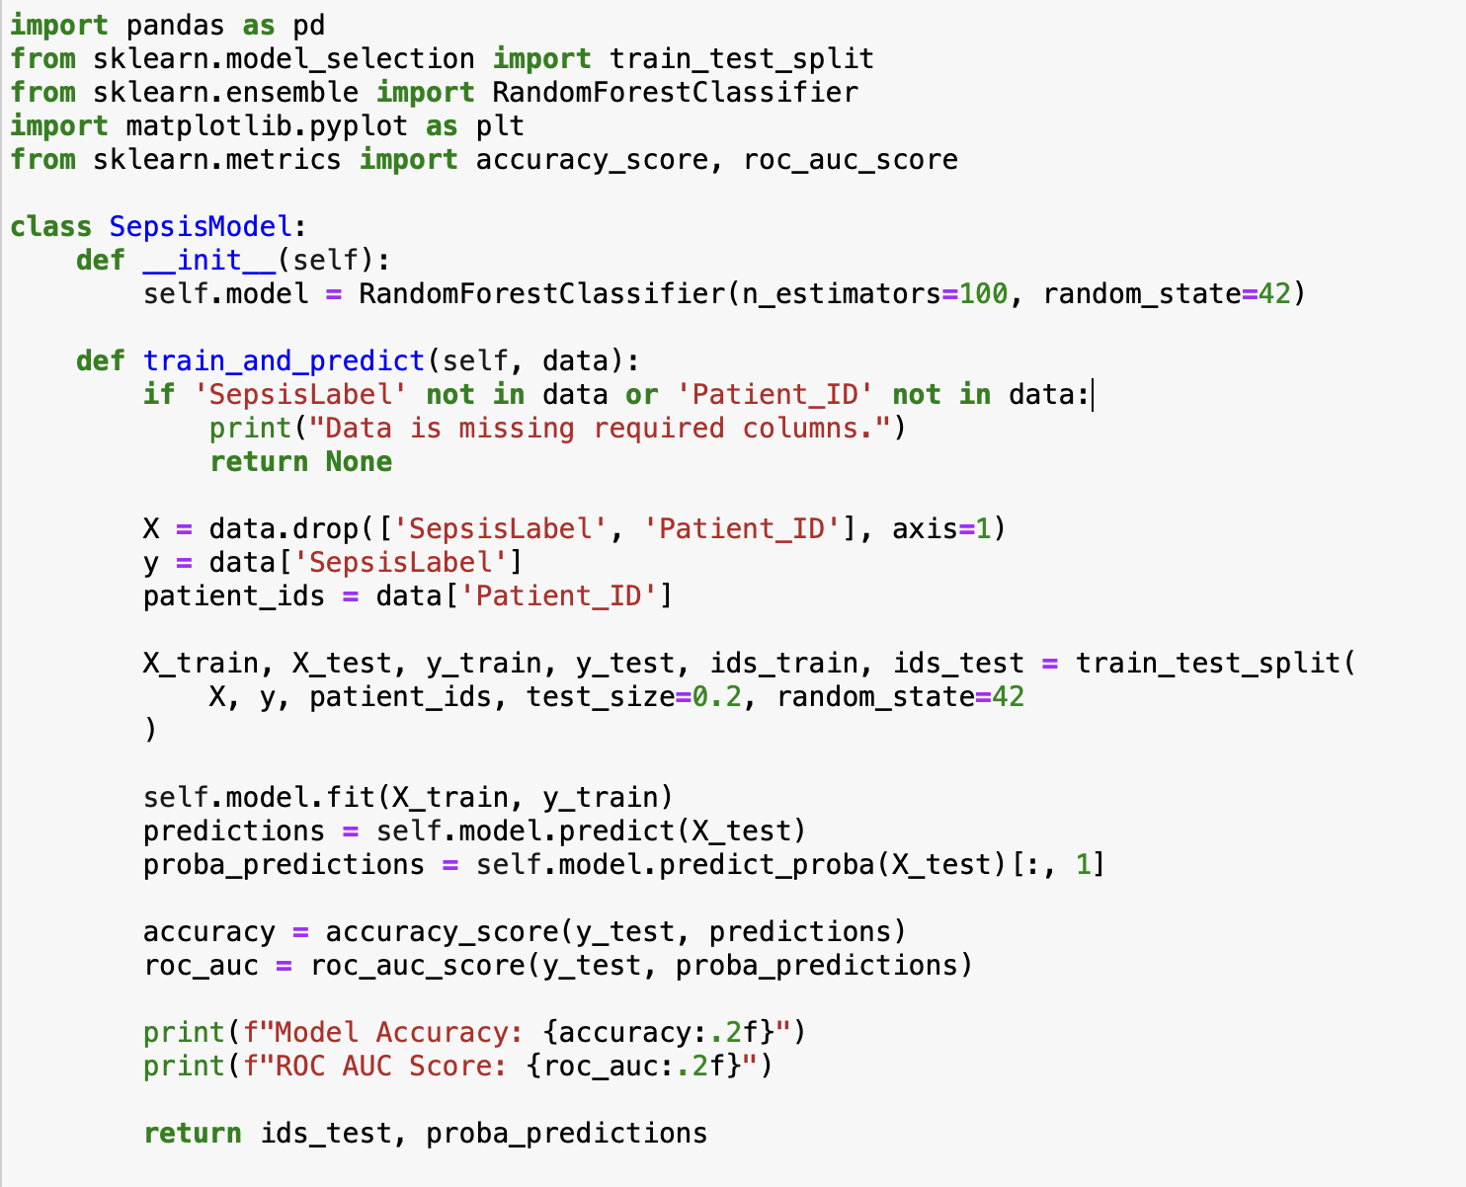
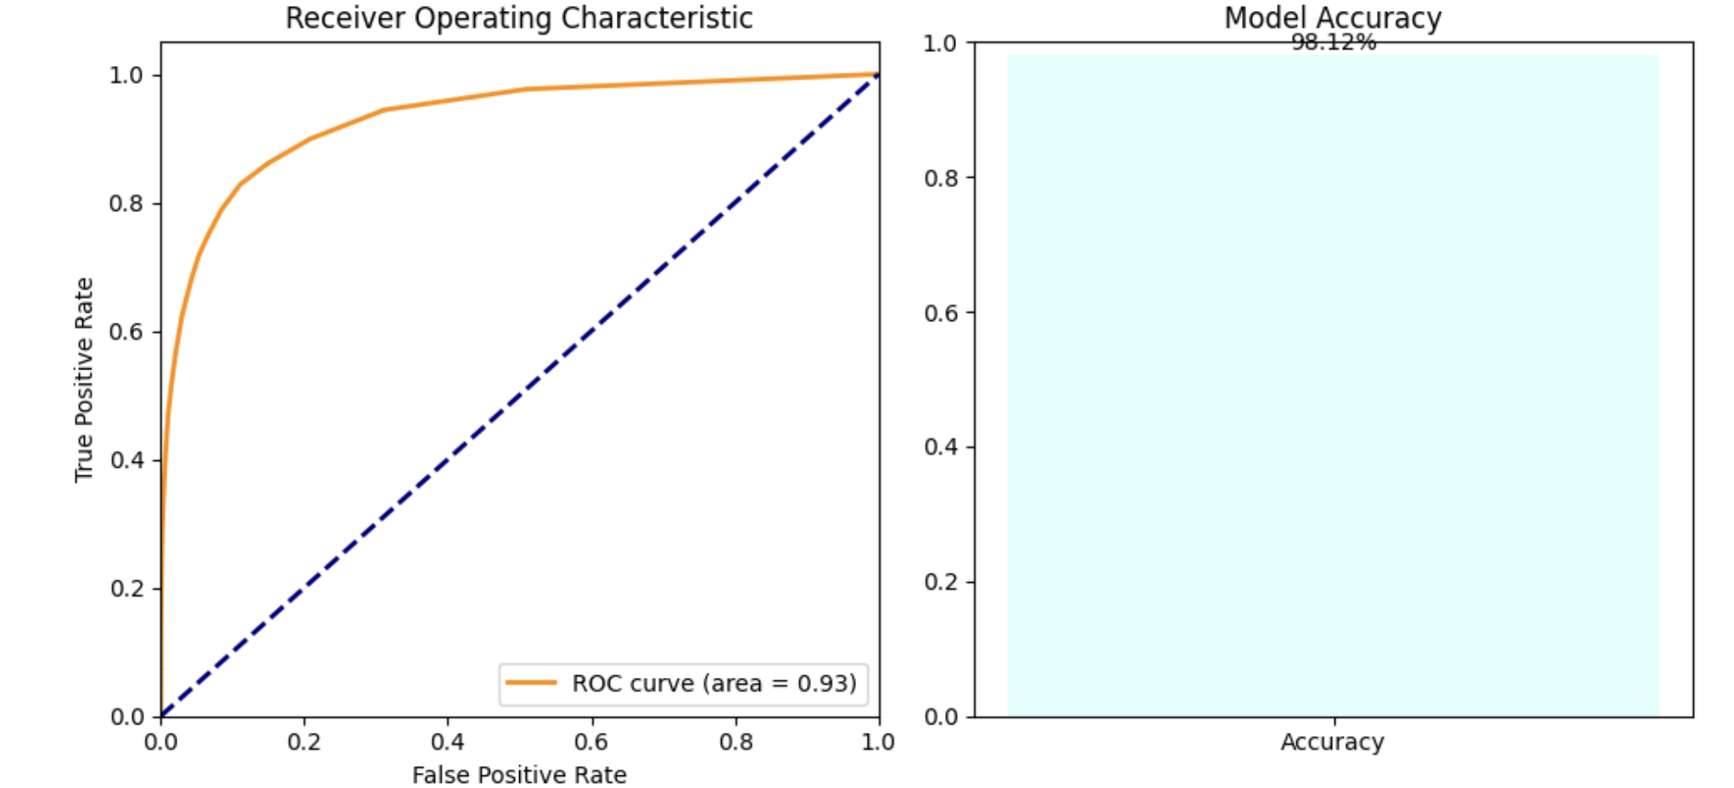
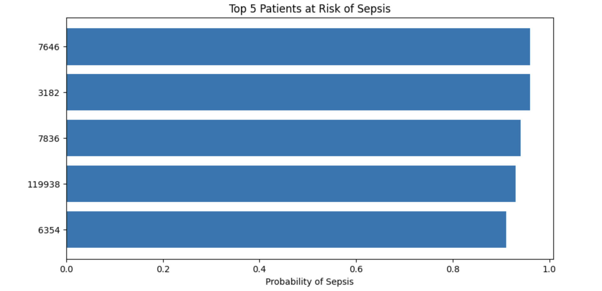
Advisor Name: Dwight Farris, PhD
Grand Canyon University
Early Sepsis Detection in Burn Patients
Claudia Islas, BSE
INTRODUCTION
DATA MODEL
RESULTS
Each year, the United States reports about 1.7 million sepsis infections leading to approximately 270,000 deaths. Burn patients are particularly vulnerable to infections due to the loss of their skin, the primary defense against microbial invasion.
The American Burn Association (ABA) initiated a specialized set of criteria for diagnosing sepsis and shock in burn patients. Despite the efforts, the effectiveness of these criteria remains under scrutiny, prompting further research and proposals for new diagnostic criteria such as the BURN-6 (ABA, 2007). The purpose of this study is to use machine learning algorithm to predict sepsis in burn patients, a critical step towards mitigating the high rates of morbidity and mortality associated with sepsis in an already vulnerable population. The secondary objective is to use the machine learning algorithm to enhance early diagnosis and treatment strategies to help improve outcomes for burn patients at risk of developing sepsis.
The data underwent preprocessing to handle missing values and normalize the data. Descriptive statistics were computed to assess data distribution, and visualizations created to confirm normal distribution across key features .
RandomForestClassifier was used from the Scikit-learn library in Python. The model was configured using 100 trees. The model was initialized with a fixed random state to ensure reproducibility of results across different runs.
Clinical identifiers ‘SepsisLabel’ for outcome classification and ‘Patient_ID’ for tracking individual patients were isolated. 20% of the data was allocated for testing to evaluate the model’s effectiveness.
The model was trained on the training dataset and evaluated on the testing set. Performance metrics, including accuracy and ROC AUC score were calculated to measure the model’s ability to predict sepsis accurately.
Using the trained model, predictions were made to identify patients at risk of sepsis. Patients with a predicted probability were flagged as high-risk. These are listed to provide clinicians with this information for early intervention.
Feature selection was completed to determine the top 5 features indicative of sepsis:
An alert system was completed via text using a Twilio account.
Message sent successfully:
CONCLUSION
The RandomForestClassifier demonstrated a high accuracy score of 98% using this database, indicating a strong ability to correctly classify cases. The ROC AUC score of 0.93 suggests a robust discriminatory ability between the sepsis and non-sepsis classes.
The feature importance provided information into the variables that contribute to sepsis prediction. These included: Age: older patients are at higher risk of sepsis, “HospAdmTime” (the time since hospital admission) shows that longer length of stay increases risk of sepsis, “ICULOS” length of stay in the ICU shows that the longer the ICU stay the higher the risk of sepsis, both “HR” Heart Rate and “SBP” Systolic Blood Pressure were strong predictors of sepsis detection. Respiratory rate as well as diastolic blood pressure were also contributors, indicating that cardiovascular function is a key indicator of sepsis prediction.
The model’s high accuracy and AUC score confirm that the model can be a reliable tool in the early detection of sepsis. This can be crucial for improving patient outcomes through timely intervention.
METHODS
RESULTS
This is a retrospective chart review of patients admitted to the Arizona Burn Center (ABC), Valleywise Health designed to create a machine model using Random Forests for the early detection of sepsis in burn patients.
The study period was from 2015-2023. Patients who were > 18 years old, had burn > 20% TBSA, who had completed records, and lived more than 72 hours were included in the analysis. There were 100 patients who were completed and a total of 150 who still need to be collected. Demographics, Medical History, Laboratory Data, Vital Signs, Medications, Surgeries, were collected for the study.
Since I did not have enough data to complete the algorithm, I used a larger sepsis database and used the data that matched my database to build a larger database. This added approximately 600,000 patients. Python was utilized to create the prediction algorithm using Random Forests.
Below is the algorithm used to train the model using RandomForestClassifier:
The results show the following:
FUTURE RESEARCH
Future research for this project includes completing the database for the Burn Center. Implementing the model into the EHR system and comparing it using live data.
REFERENCES
1. Burdick, H., et al. (2020). Validation of a machine learning algorithm for early severe sepsis prediction. BMC medical informatics and decision making.
2. Greenhalgh, D. G., Saffle, J. R., Holmes, J. H., 4th, Gamelli, R. L., Palmieri, T. L., Horton, J. W., Tompkins, & et, al. American Burn Association Consensus Conference on Burn Sepsis and Infection Group (2007). American Burn Association consensus conference to define sepsis and infection in burns. Journal of burn care & research : official publication of the American Burn Association, 28(6), 776–790. https://doi.org/10.1097/BCR.0b013e3181599bc9Fleuren, L. M., et al. (2020). Machine learning for the prediction of sepsis: a systematic review and meta-analysis. Intensive care medicine.
3. Rech, M. A., et al. (2019). Outcomes in Burn-Injured Patients Who Develop Sepsis. Journal of burn care & research.
4. Singer, M., et al. (2016). The Third International Consensus Definitions for Sepsis and Septic Shock (Sepsis-3). JAMA
5. Prediction of Sepsis. (2019). https://www.kaggle.com/datasets/salikhussaini49/prediction-of-sepsis
Thank you to GCU faculty, peers, clinicians for their support and guidance.

